Slide 1

Intent
Phonics
Intent

Slide 2
Phonics
Why is phonics important?
At Wells Hall Primary, we believe that all pupils deserve a high quality systematic, synthetic phonics programme that will enable them to rapidly learn sounds and the letters they need to represent them. We use a speech-to-print approach, starting with what children learn naturally, the sounds of their language and how to represent these sounds in writing. Our phonics scheme provides a conceptual framework that helps pupils make sense of the relationship between the sounds of the English language and our writing system. This learning is consolidated daily and children are given regular practice in decoding, blending and manipulating phonemes. We ensure pupils are provided with books that closely match their increasing knowledge of phonics.
Intent

Slide 3
Phonics
Aims of the Phonics Curriculum
Through a carefully crafted sequence, Sounds-Write starts by introducing students to one-to-one sound-letter correspondences through the Initial Code. It then moves on to teach the complexities of the English alphabetic code through the Extended Code and, at the same time, students are taught how to read polysyllabic words. New learning is introduced within each unit but the programme is cumulative, so all of the previously taught content continues to be practised as the student progresses. Throughout this, students are trained to be proficient in the skills needed to read and spell effectively, namely, segmenting, blending and phoneme manipulation, and are also taught explicitly the conceptual knowledge that is essential to make sense of the English alphabetic code.
Intent

Slide 4
Shared Vision
We are passionate in our belief that no child should leave school unable to read and spell. We strongly believe that if educators have a good understanding of how the writing system works and how to teach it, and follow the approach with fidelity, they can successfully teach their students to read and spell. The Sounds-Write programme is discussed, taught and practised in a supportive way and teachers receive coaching from the Early Reading lead and have access to additional support materials via the Sounds-Write portal. All staff who teach Sounds-Write have received in depth training supported by a consultant from the Sounds-Write training team.
Intent

Slide 5
In Sounds-Write Phonics pupils will develop skills in:
● Segmenting -– the ability to pull apart the individual sounds in words.
● Blending – the ability to push sounds together to build words.
● Phoneme manipulation – the ability to insert sounds into and delete sounds out of words.
They will be able to perform these skills proficiently in simple 3, 4 and 5 sound words with different structures. They will learn that:
● We spell sounds one at a time from left to right across the page.
● Letters are symbols (spellings) that represent sounds.
● A sound may be spelled by 1, 2 or 3 letters. And they will begin to have an understanding that:
● The same sound can be spelled in more than one way.
● Many spellings can represent more than one sound.
Intent

Slide 6
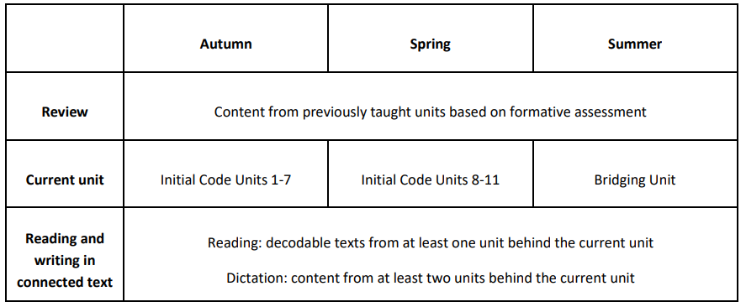
Reception Overview
Intent

Slide 7
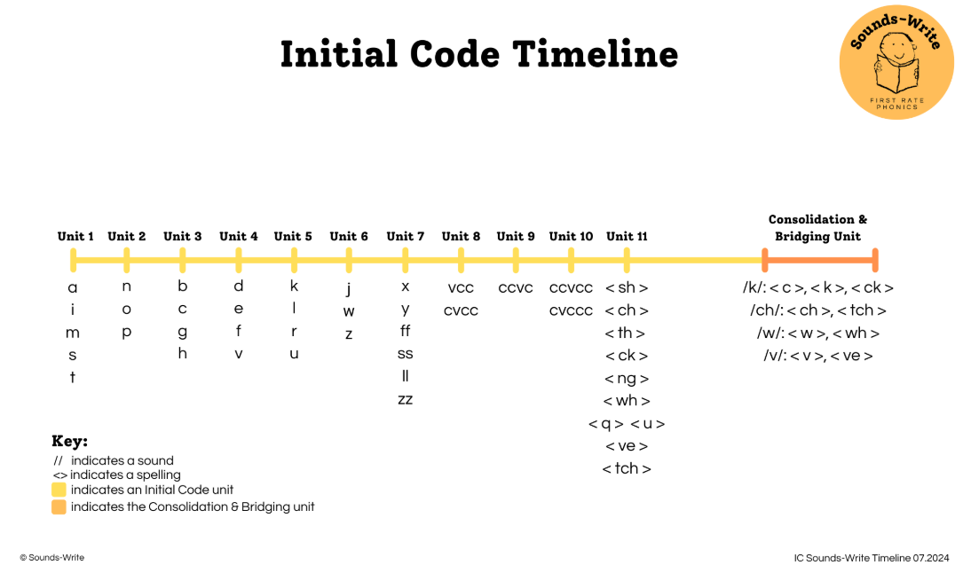
Intent

Slide 8
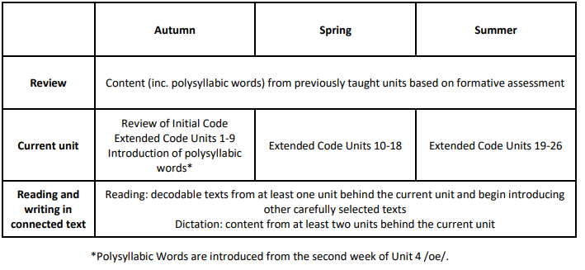
Year 1 Overview
Intent

Slide 9
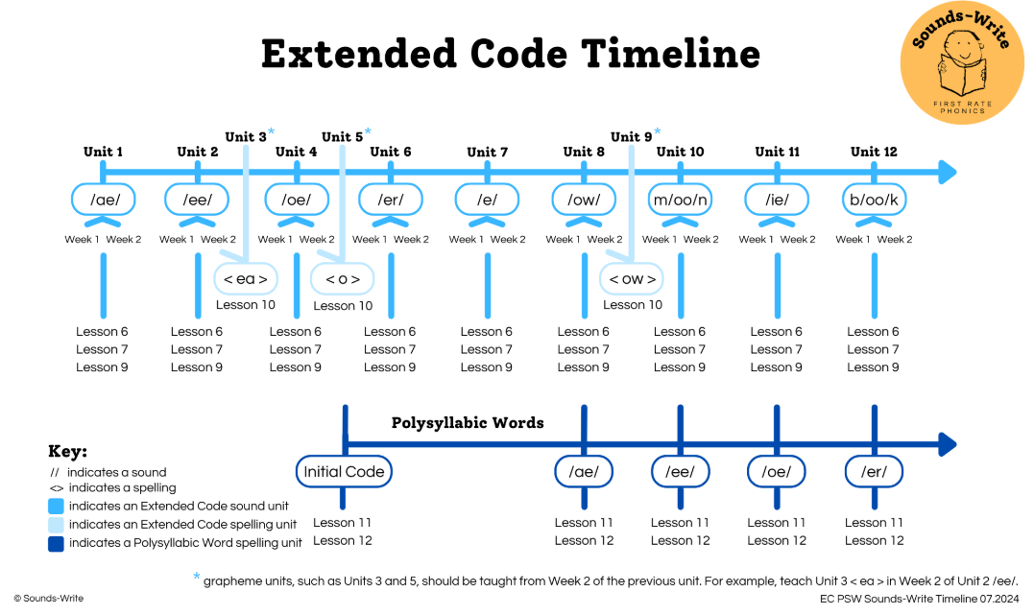
Intent

Slide 10
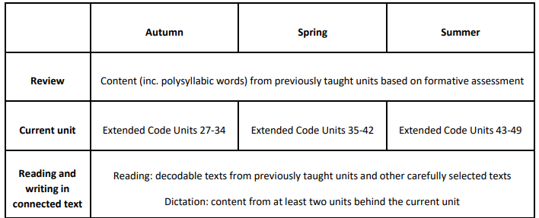
Year 2 Overview
Intent

Slide 11
Phonics
Implementation
Implementation

Slide 12
Assessment:
In June, children in Year 1 will undertake the Phonic screening check. This consists of 40 words, 20 real words and 20 pseudo words. Children who do not pass the Phonic screening check in Year 1 will have the opportunity to retake this in Year 2 alongside tailored interventions.
Children within Key Stage 2 who did not pass the Phonic screening check in KS1 will receive tailored Phonics interventions 1-1 and/or in small groups.
Implementation

Slide 13
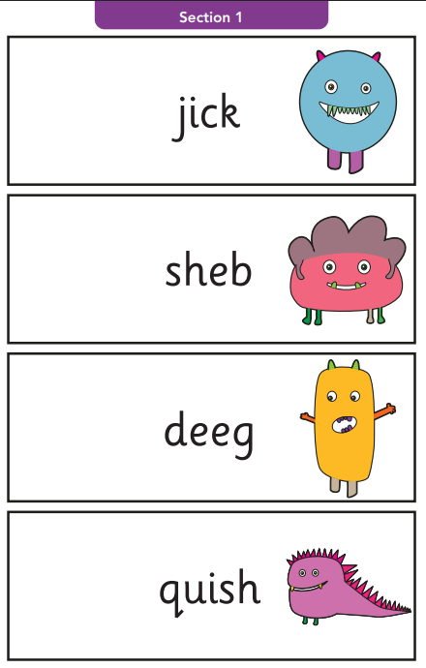
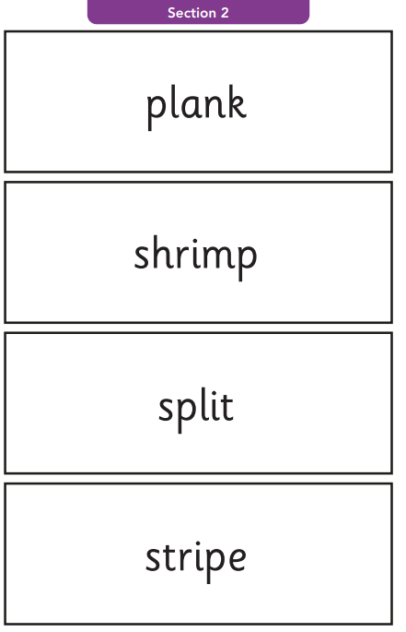
Example of the phonics screening check
Implementation

Slide 14
Families
We ensure information is shared with families so that they are well-informed as to how they can effectively support their child with reading and spelling at home. This is offered through workshops, information sessions, newsletters and online resources.
Through our rigorous assessment of pupils, we ensure that pupils are provided with appropriate books to take home for reading.
Implementation

Slide 15
Keep-up and Catch-up
We ensure interventions are properly resourced, delivered and evaluated to achieve their aim of helping students catch up and keep up with their learning.
Keep-up interventions are used to repeat the content of the main lesson, working on those elements the children need more practice with.
Catch-up interventions are used for students who, for whatever reason, have gaps in their learning. They involve identifying and working on any gaps in students’ skills, code knowledge or conceptual understanding.
Implementation

Slide 16

Resources and Staff Development
Staff involved in teaching and supporting Sounds-Write have been given access to training and develop their Sounds-Write practice through ongoing professional development. They also have ongoing access to the Sounds-Write Practitioners’ Portal which contains professional development videos and webinars to enhance their practice.
Staff have a clear understanding of the planning, implementation, resources and assessment required and are regularly supported and monitored to develop their practice and use Sounds-Write with fidelity and confidence.
Implementation

Slide 17
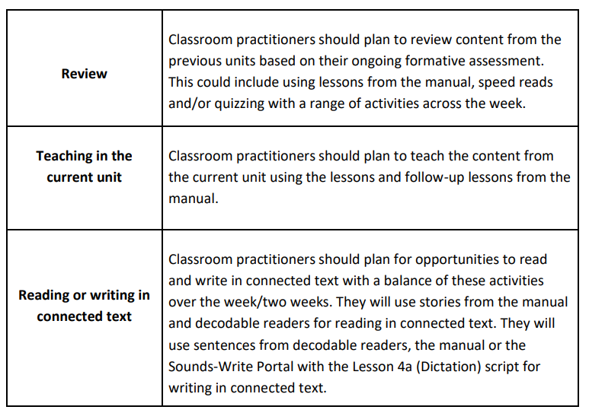
Lesson sequence
Implementation

Slide 18
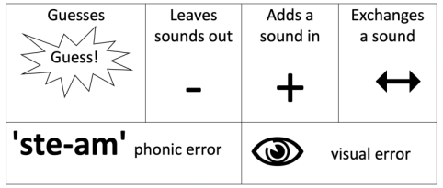
Teaching through errors
Within our daily Sounds-Write lessons errors are used as an important learning opportunity. Practitioners are trained in and use the Sounds-Write Teaching Through Errors scripting, to ensure consistency during phonics sessions and when listening to children read. Teaching Through Errors is covered in detail during initial training and staff are provided with scripting in their Sounds-Write manuals.
Implementation

Slide 19

Connection to prior learning
The decodable books that children bring home are from at least one unit behind what children are currently learning in their phonics lessons and are often books they have already read in school with guidance from their teacher.
Through this children are encouraged to consolidate their learning at home and increase their fluency.
Implementation

Slide 20
Adaptive teaching
Staff carefully consider how to adapt whole-class phonics sessions to meet the needs of all learners. They use a variety of scaffolding techniques such as:
● Careful selection of the words chosen to be built, read and written in terms of structure
● Choosing words with more or fewer continuants
● Using lines or no lines.
● Using more or fewer gestures.
● Leaving the word, or part of the word, on the board for the students to write
● Carefully considering which students will come to the front to build the first and subsequent words, and who will read the word first versus who will repeat this as the second or third reader.
Implementation

Slide 21

Phonics
Impact​
Impact

Slide 22
Observations and Feedback
Senior and subject leaders regularly observe lessons and check planning to ensure progress within lessons. This includes sessions with small groups of pupils using questioning to check and ensure information and knowledge is acquired and understood with increasing confidence.
Ongoing Teacher Assessment and Development
Assessment is used by teaching and support staff to inform future planning. CPD is planned to allow staff to be confident in making sure the children are performing to the best of their ability and acquiring the skills and knowledge needed.
Impact

Slide 23
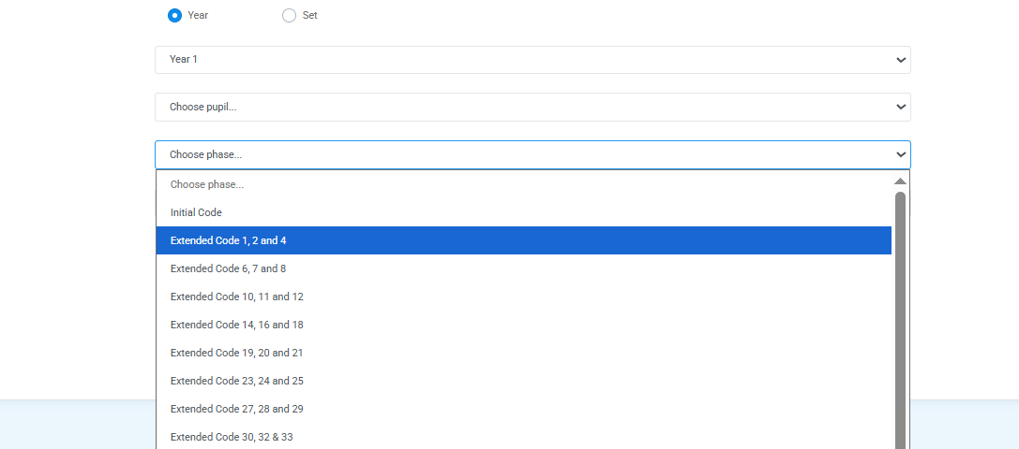
Code assessments
Code checks are carried out with pupils in Reception – Year 2 to assess retention and indicate possible gaps in their code knowledge. These checks are used to inform whole class planning as well as instantly identify pupils who may need catch-up interventions.
Impact

Slide 24
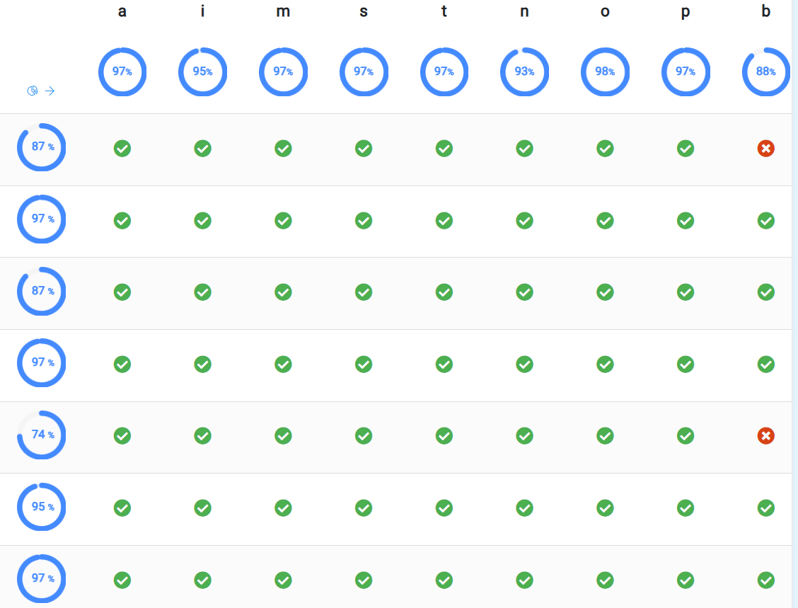
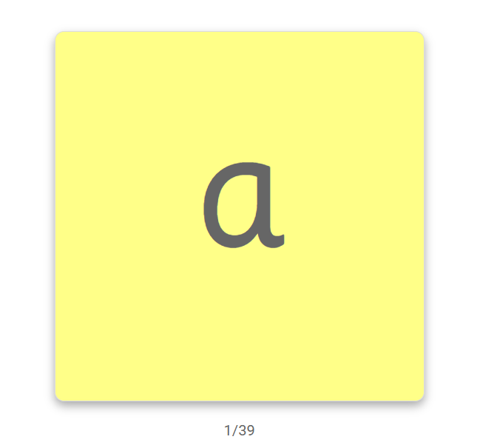
Example of Initial code check
Impact

Slide 25
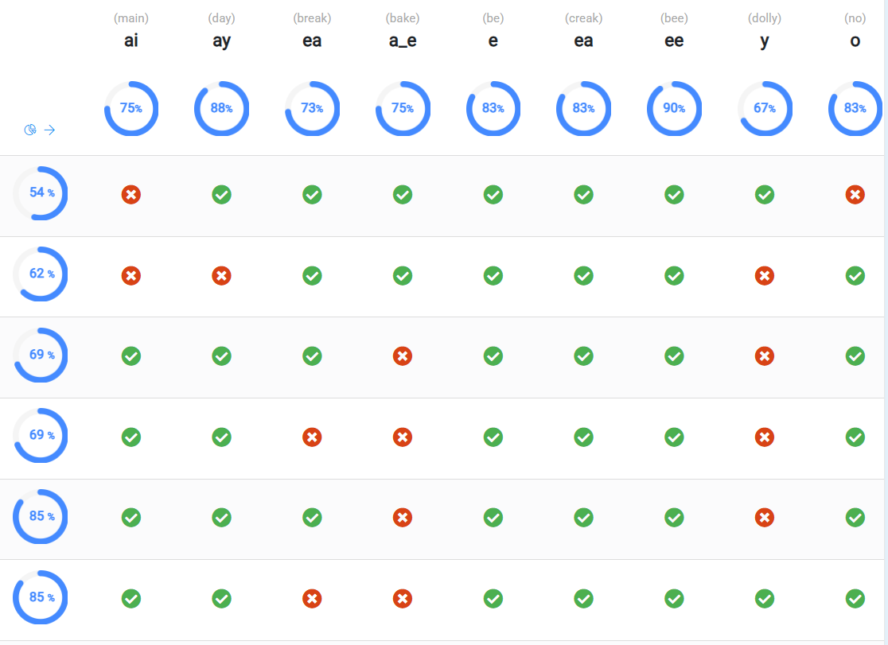
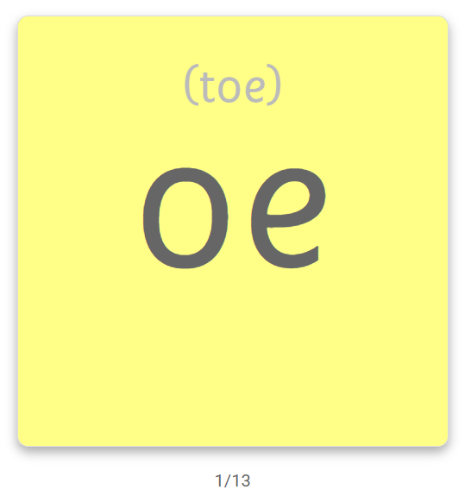
Example of Extended code check
Impact

